Slide 1



The Necessity of Human and AI Hybrid Decision-Making in Data Science Megan Wilder – Expected Graduation: Spring 2025
Dr. Kevin Gittner
INTRODUCTION
DISCUSSION
The development speed of AI technologies has increased exponentially in recent years and shows no signs of stopping any time soon. As the capabilities of large language models expand beyond simple queries and into territory once fully claimed by experts, there are rising concerns about how to keep AI in check to ensure ethical usage. I would argue that data science is at a greater ethical risk than most other fields regarding the widespread adoption of AI models and tools as there is dangerous potential for misinformation. Many data science practices such as data mining, for example, require a fundamental understanding of context and the intricacies of human behavior, both of which AI struggles to emulate, let alone understand.
Ethical Stance:
But What About…
Let’s Discuss!
Not only do we need to keep humans involved in AI decision-making, but we also need those we are placing in these roles to have proper education and expertise in the relevant fields to ensure ethical and accurate data results are produced.
…Efficiency?
Won’t the inclusion of humans slow down our ability to make business decisions?
…Automation bias? What’s stopping the humans involved from just approving whatever the AI produces?
BACKGROUND
…Accuracy?
Hasn’t AI been shown to be more accurate than humans on average?
Ethical Considerations and Risks of AI Decision-Making
The technical accuracy of AI results remain unchecked prior to decision-making.
AI does not consider context or societal effects of the decision it makes.
This also means that AI will not explain potential contextual or ethical considerations to the relevant stakeholders and businessmen.
The average person’s comfort regarding the use of AI has been shown to be lower than humans in cases where a mistake has been made.
How Human Intervention Can Solve These Issues
The use of experts in data science can ensure the accuracy and quality of AI-produced work.
The involvement of humans will help prevent models produced with bias or models produced using unethical methods.
Additionally, having a human as an in-between communicator can help prevent unethical suggestions being presented to stakeholders and businessmen.
The average person will feel more comfortable knowing humans were involved in situations where financially or ethically important decisions are being made.
HOW DO WE APPLY HYBRID DECISION-MAKING?
A commonly referenced concept for understanding and applying human and AI hybrid decision-making is “Human-in-the-loop,” sometimes shortened to HITL. Crootof provides some helpful recommendations regarding the implementation of HITL that can be considered for policy-making on both the corporate and government levels.
Recommendations for Implementation of HITL:
Clearly identify the human’s intended role.
Ensure the technology grants sufficient access for the human to view and/or change relevant information.
Context of the problem should be considered when deciding what role humans should play.
Pull from existing examples of successful hybrid system regulations.
Ensure the usability of the system wherever humans are expected to interact with it.
Humans should be able to receive relevant and timely feedback from the AI.
The AI should be responsive to human input.
The design of the technology should facilitate organizational resilience.
This ensures the smooth transfer of data between human and AI.
SOURCES
Github / References:
LinkedIn:

Slide 2
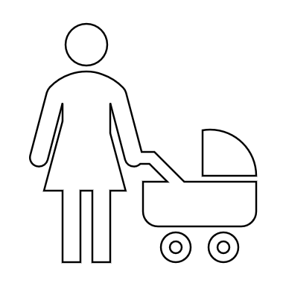


We Need to Babysit AI Here’s Why
Megan Wilder – Expected Graduation: Spring 2025

